Slide 1
Photo Album
by Sriramoju Sathish

Slide 2
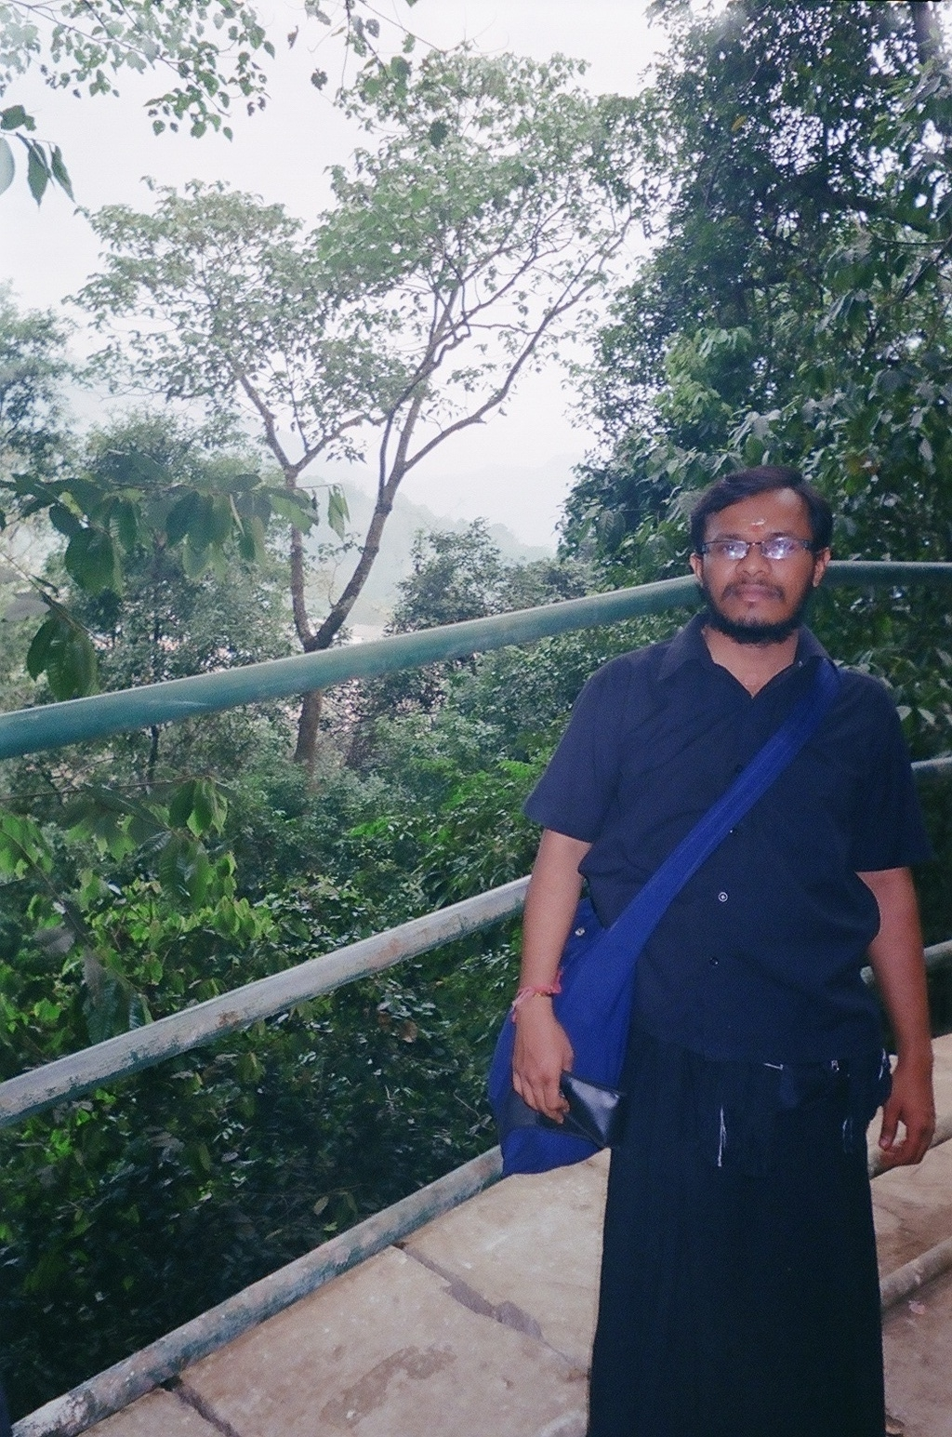
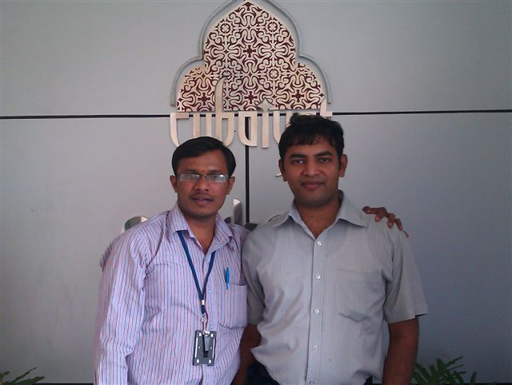
IMAG0045
65490028

Slide 3
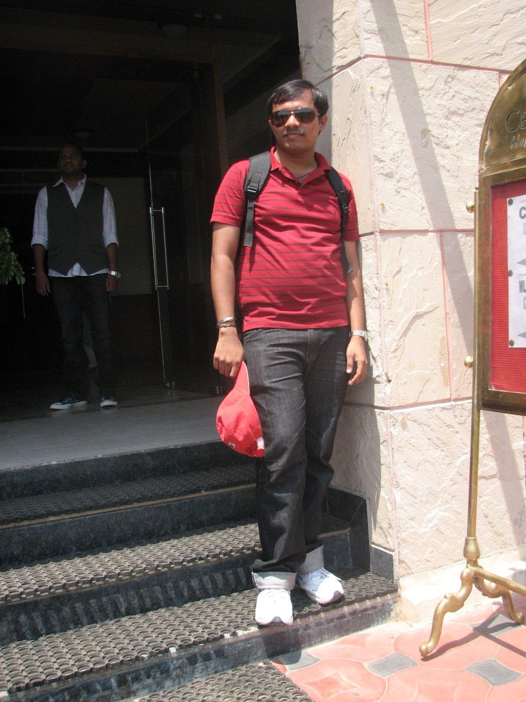

Sathish Sriramoju
Outing_24

Slide 4
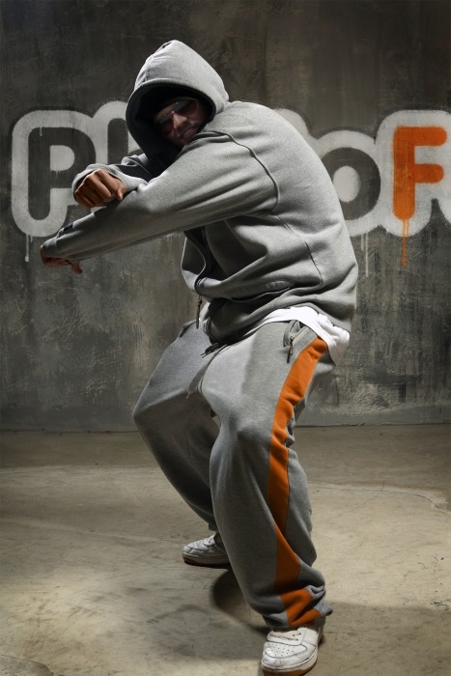
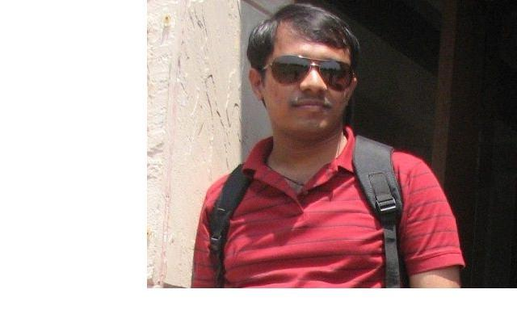
Sathish Photo For Floor Walk
Updated Photo

Slide 5
Text Box

